Slide 1






Is Conversational XAI All You Need? Human-AI Decision Making With a Conversational XAI Assistant
Gaole He, Nilay Aishwarya, Ujwal Gadiraju
Yutong Liu & Kingston School of Art
/ Better Images of AI / Talking to AI / CC-BY 4.0
Notes:
Hello, everyone!
Today, I will show you our recent work – an empirical study about conversational XAI interfaces and its impact in human-AI decision making.

Slide 2
Background & Motivation
Notes:
First, we introduce the background and motivation of this work

Slide 3

Rise of Artificial Intelligence
Moth?
Butterfly?
Background | Motivation | Study Design | Take-away
Notes:
You are all aware of how AI is adopted across many domains and affect our daily life.
Here is one example of using AI to help experts detect the butterfly species.
However, it can also make errors, like recognizing a moth as a butterfly

Slide 4




Human-AI Decision Making
AI Error
To Err Is AI! Debugging as an Intervention to Facilitate Appropriate Reliance on AI Systems. Gaole He, Abri Bharos, Ujwal Gadiraju. Hypertext 2024
Background | Motivation | Method | Results
Notes:
Due to the intrinsic opaqueness of deep learning systems, automating critical decision making by using AI systems is far from reliable
A lot of people expressed their concerns about unsupervised decision with AI systems.
Under such circumstances, AI-assisted decision making or human-AI decision making seems a more promising alternative

Slide 5



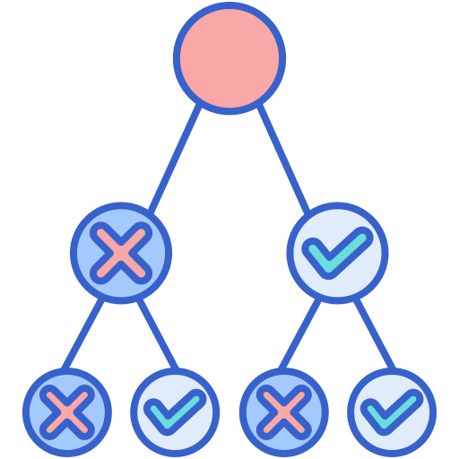
Towards Optimal Human-AI Decision Making
Informed Decision Making
Is AI advice trustworthy?
Complementary team collaboration --- Calibrated trust and appropriate reliance
Post-hoc XAI methods
Feature Attribution (e.g., SHAP, LIME)
Counterfactual Reasoning
Decision Tree
…
Background | Motivation | Method | Results
Notes:
In such a collaborative decision making process, explanations matters!
To make informed decisions, users of the AI system need to determine whether the AI advice is trustworthy.
And further, they need to calibrate trust and appropriate rely on the AI systems.
Thus, explanations are incorporated to increase intelligibility and ensure that decision makers can make informed decisions
For example, researchers have proposed different post-hoc XAI methods to help explain AI predictions from different angles, which also satisfy different user information needs.

Slide 6
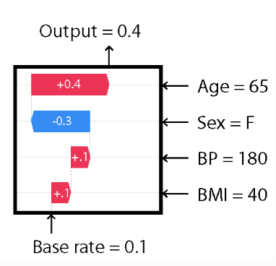
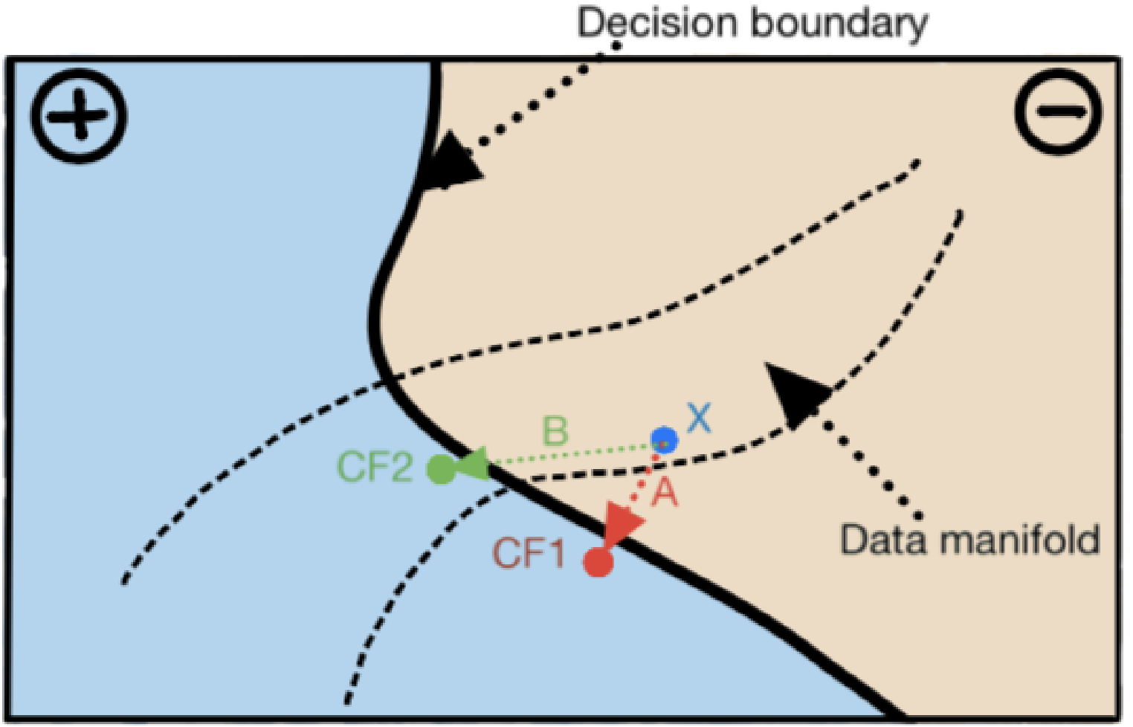
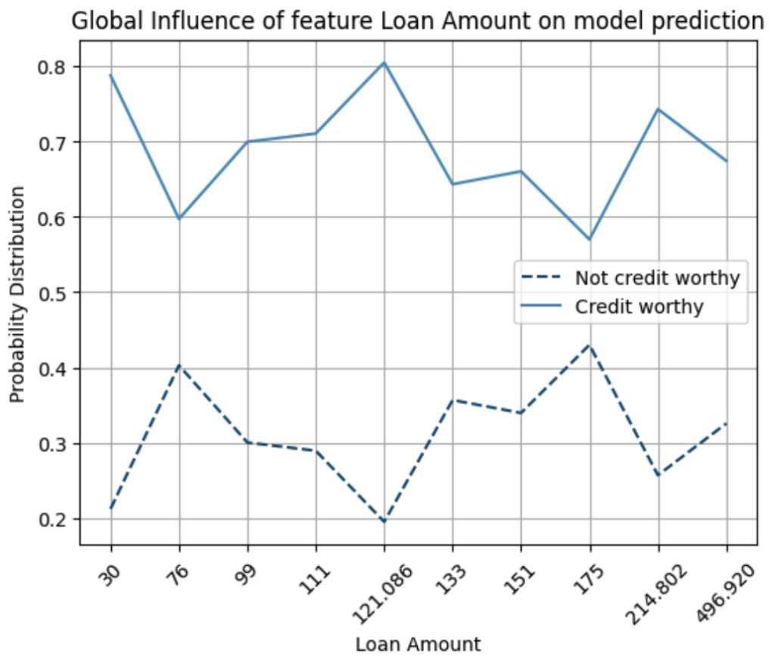
Diverse User Information Needs
Feature Attribution
Counterfactual explanation
Global explanation
Background | Motivation | Method | Results
Notes:
For example, to understand how AI systems reach a specific decision, we may need to understand the importance of input features.
To provide actionable suggestions, we may need counterfactual explanations
To develop a global understanding of the impact of data, we may need some global explanations like data distribution.

Slide 7
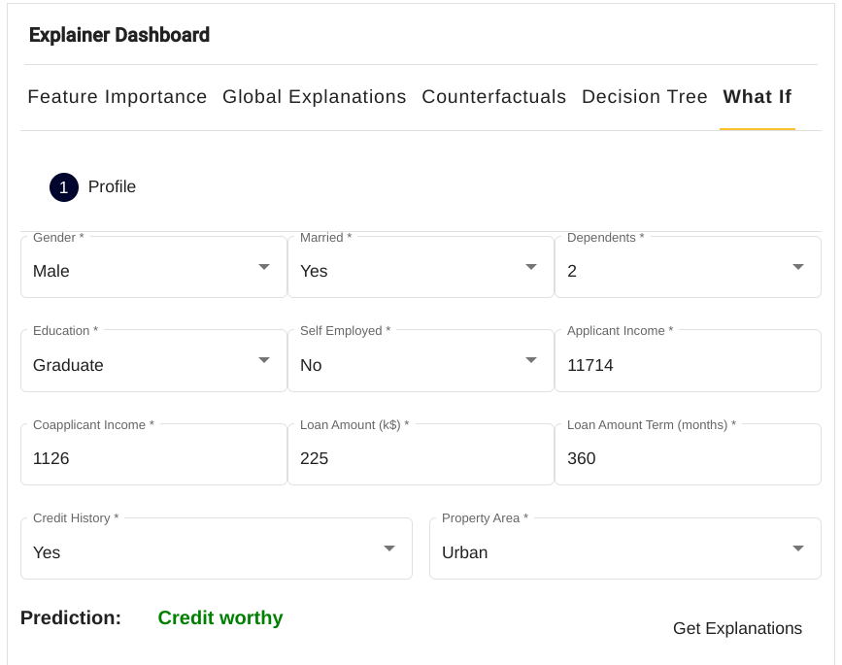
XAI Dashboard: As a One Shop Stop
Background | Motivation | Method | Results
Notes:
Instead of selecting a single specific explanation, an XAI dashboard enables users to explore their information needs by explanations on demand.
In other words, you can get any explanations available and explore them as you wish.
Such an interactive interface brings both simplicity and completeness, and has been recognized as an effective design.

Slide 8






Motivation: why conversational XAI?
Challenges in using XAI
It requires necessary AI knowledge and experience
Not all users can articulate their information needs and find suitable XAI methods
Conversational XAI interfaces
Human-like interaction and simplify complex tasks with filtered information
Boost user understanding through improved exploration of information needs
Background | Motivation | Method | Results
Notes:
However, not all users have the necessary AI knowledge and experience to understand or benefit from such explanations.
Nor can all users articulate their information needs and find suitable XAI methods to address their concerns
Therefore, we need a more flexible, dynamic, and personalized approach to resolving users’ explanation needs.
That is, conversational XAI interfaces.
Prior work has shown that
First, conversational user interfaces can provide a human-like interaction and simplify complex tasks with filtered information.
Second, augmenting XAI methods with conversational interfaces can potentially boost users’ understanding of the AI system through an improved exploration of their explanation needs.

Slide 9
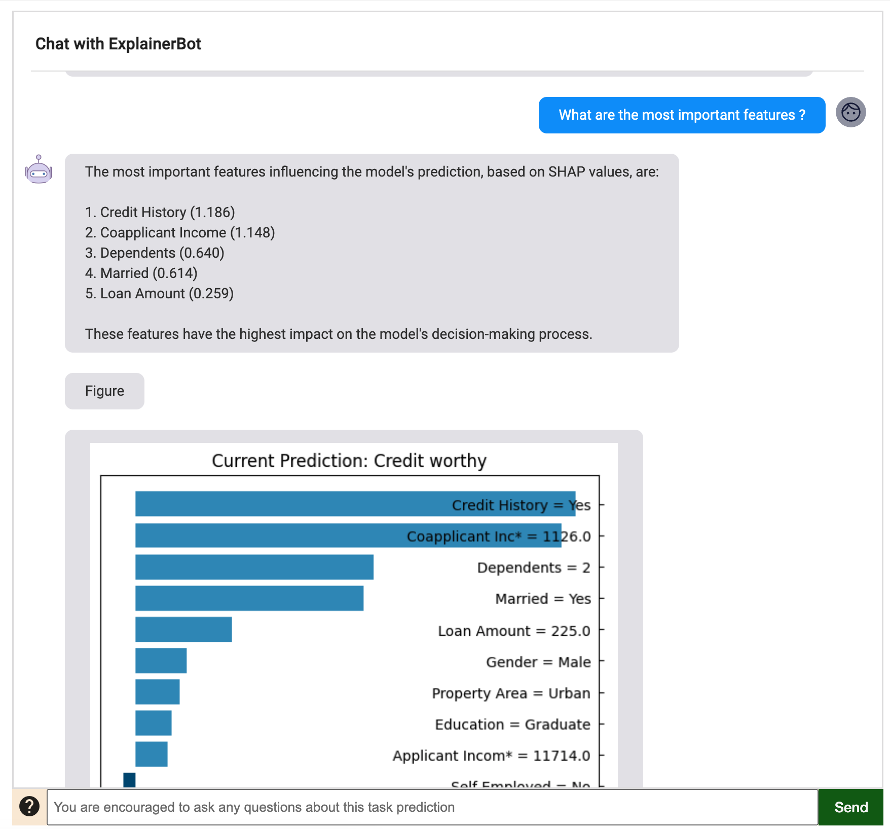
XAI Dashboard vs. Conversational XAI Interfaces
Is conversational XAI all we need?
Does it work better than XAI Dashboard?
XAI Dashbord
Conversational XAI Interface
Background | Motivation | Method | Results
Notes:
Considering the benefits of conversational XAI interfaces, it seems a very promising future interface for supporting human-AI decision making.
In this work, we want to check: is conversational XAI all we need? Does it really work better than XAI dashboard?

Slide 10
Research Questions
RQ1: How does a conversational XAI interface shape user understanding of an AI system, in comparison with the XAI Dashboard?
RQ2: How does a conversational XAI interface influence user trust and reliance on an AI system, in comparison with the XAI Dashboard?
Background | Motivation | Method | Results
Notes:
Specifically, we want to compare the conversational XAI interface and XAI dashboard mainly on two aspects.
First, the impact on user understanding of an AI system
And second, the impact of user trust and reliance on an AI system

Slide 11
Method
Notes:
Then, I will show you the designed conversational XAI interface and user study in our work

Slide 12
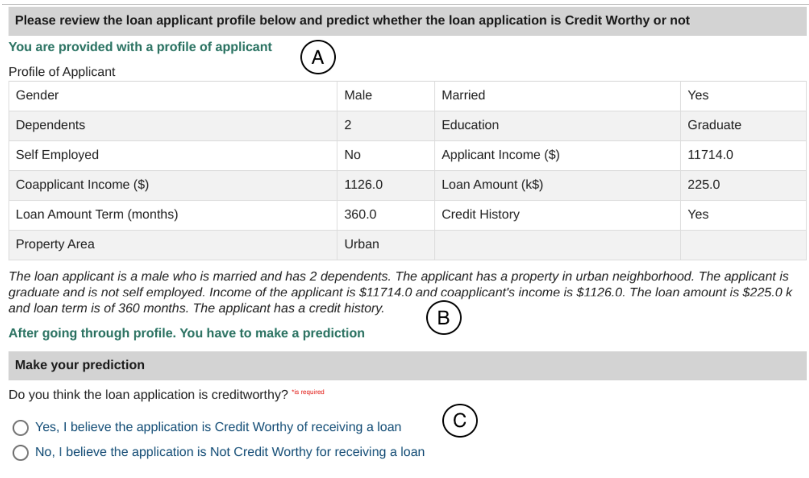

Loan Approval Task
Background | Motivation | Method | Results
Notes:
In our study, we selected a loan approval task, where participants are asked to view an loan application, which consists of 11 features.
And make a binary decision about whether the loan application is credit worthy.
[next slide]
Why Loan Approval
Critical Decision Making
Suitable for laypeople
Adopted in prior work for human-AI decision making

Slide 13


Conversational XAI Assistant
Hi AI, check this loan application. Do you think I should approve it?
CXAI (rule-based)
Smooth user experience
Guide users in exploring their information needs
I would suggest rejecting this application.
Can you give concrete reasons? I want to know what factors lead to your suggestion.
Evaluative CXAI (rule-based)
Nudge users to compare their decision criteria with AI system
After checking his credit history and monthly salary, I would suggest rejecting this application.
LLM agent (LLM-based)
High-quality text responses
Natural communication with AI system
Type your message here, AI will clarify for the decision
Tim Miller. 2023. Explainable ai is dead, long live explainable ai! hypothesisdriven decision support using evaluative ai. In Proceedings of the 2023 ACM conference on fairness, accountability, and transparency. 333–342.
Background | Motivation | Method | Results
Notes:
Here we show one example in loan approval tasks with conversational XAI assistant.
Through this conversation, users get to know how AI system reach the rejection decision.
Specifically, in our study, we have three variants of conversational user interface.
The basic one, which is based on a rule-based agent with templating user intents and XAI responses.
Such a design has been observed to be effective in guiding users in exploring information needs and understanding the model decisions
To facilitate user understanding of AI system, we provide an enhanced conversational interface with adaptive steering.
This borrows the idea from evaluative AI, which will provide hint messages to nudge users compare their own decision criteria with that of AI system.
By doing so, we would expect that users can develop a more critical mindset in adopting AI advice.
Meanwhile, the LLMs can further enhance the conversation quality by providing high-quality text responses and improve conversation coherence.
Thus, we adopted another conversational XAI interface powered with LLM agent.

Slide 14
Hypotheses
Compared to the XAI dashboard, the conversational XAI interface
Better understanding (H1),
Higher trust (H2),
More appropriate reliance (H3)
Evaluative decision support in the conversational XAI interface will increase user trust and appropriate reliance on an AI system (H4)
CXAI (rule-based)
Smooth user experience
Guide users in exploring their information needs
Evaluative CXAI (rule-based)
Nudge users to compare their decision criteria with AI system
LLM agent (LLM-based)
High-quality text responses
Natural communication with AI system
Background | Motivation | Method | Results
Notes:
Based on prior work and the potential benefits brought by conversational user interface,
we hypothesize that compared to the XAI dashboard, the conversational XAI interface may creates a better understanding of the AI system, help develop a higher trust in the AI system, and also promote appropriate reliance on the AI system.
Besides that, we also hypothesize that evaluative decision support can increase user trust and promote appropriate reliance.

Slide 15
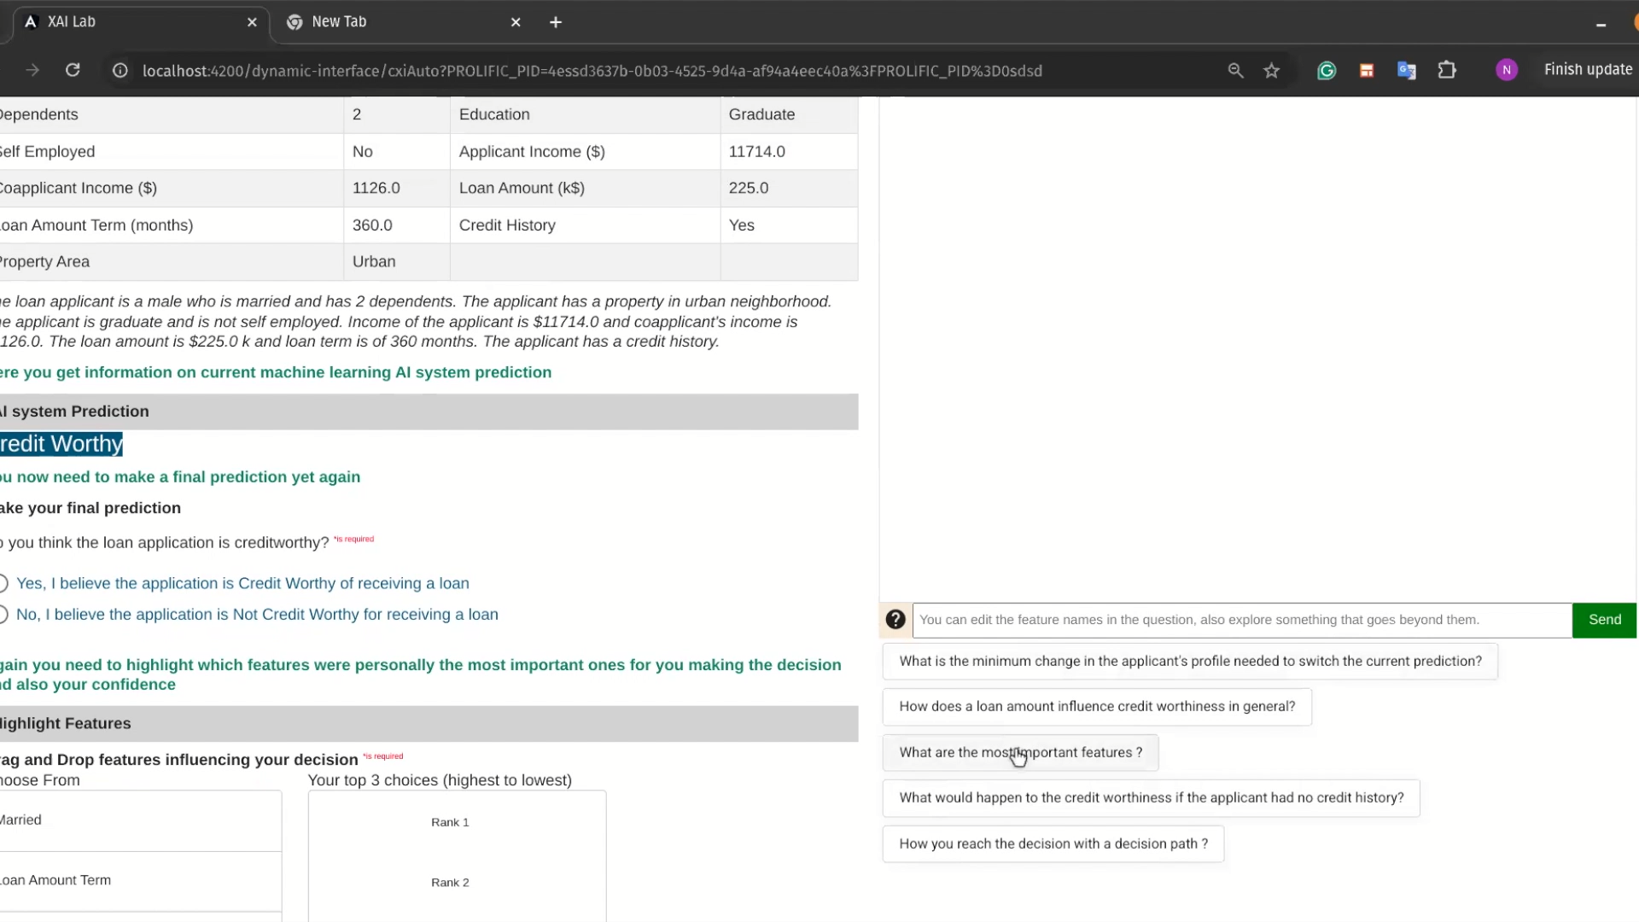
Background | Motivation | Method | Results
Notes:
Before moving forward, we use a short video to show how conversational XAI interface works in our study

Slide 16
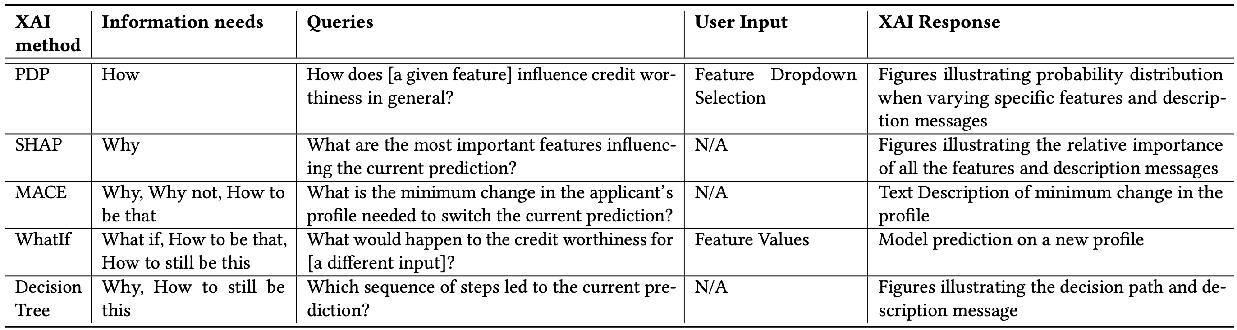
XAI Methods
https://github.com/salesforce/OmniXAI
Liao, Q. V., Gruen, D., & Miller, S. (2020, April). Questioning the AI: informing design practices for explainable AI user experiences. In Proceedings of the 2020 CHI conference on human factors in computing systems (pp. 1-15).
Background | Motivation | Method | Results
Notes:
In our implementation, we selected five representative XAI methods which stands for different user information needs.
Following the XAI question bank, we selected six user information needs associated with the rationale of AI advice: how, why, why not, how to be that, how to still be this, and what if.
In our implementation of rule-based conversational agent, we provide template for each XAI method.
These templates are also used as hint messages in the LLM-based conversational agent.

Slide 17
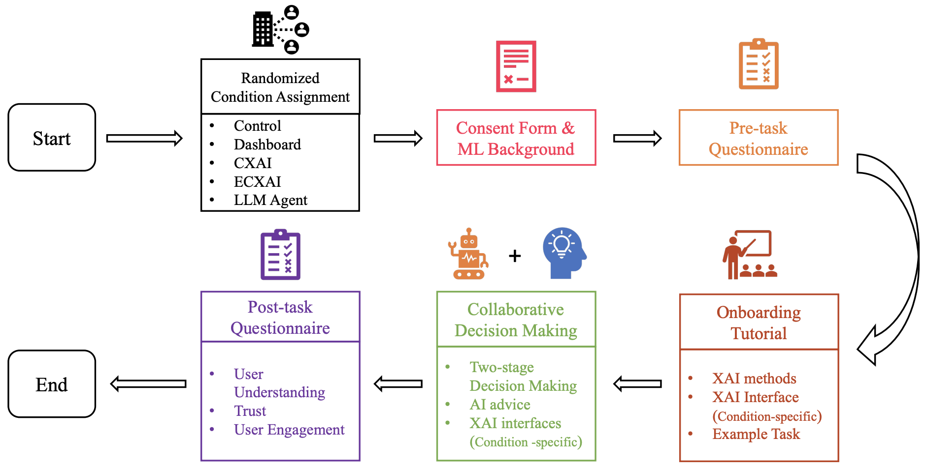
Procedure
Prolific Participants (N=306)
Control (61)
Dashboard (61)
CXAI (62)
ECXAI (61)
LLM Agent (61)
Background | Motivation | Method | Results

Slide 18
Results & Interpretation
Notes:
Then, we show the main results and our interpretation

Slide 19
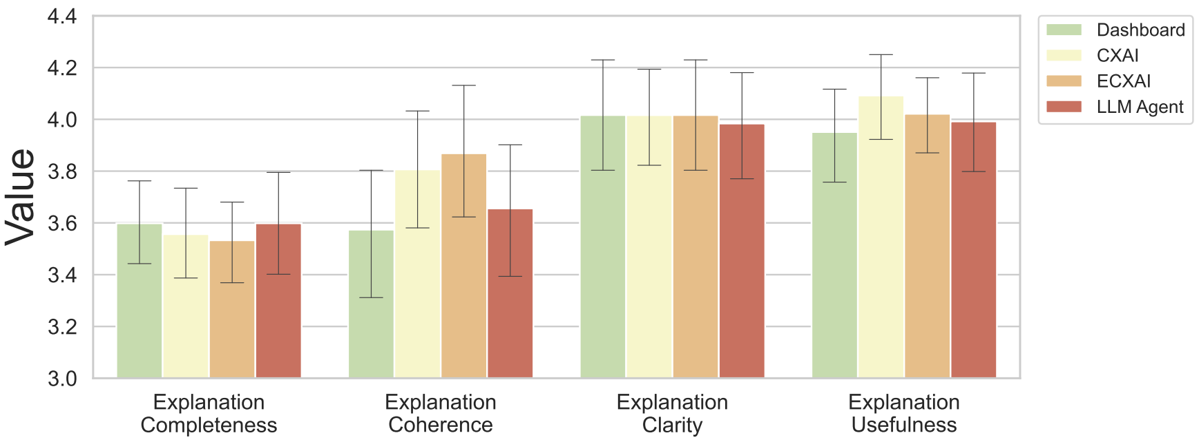
Impact on User Understanding
Slightly better explanation coherence and explanation usefulness (non-significant)
Objective feature understanding (significant)
LLM Agent < Dashboard, CXAI, ECXAI
Figure. Bar plot of explanation utility across conditions
Background | Motivation | Method | Results
Notes:
First, we checked the impact of user interface on user understanding.
Based on our statistical tests, there is no significant difference in most dimensions.
But we still observe that the participants reported higher explanation coherence and explanation usefulness when working with conversational XAI interface
Meanwhile, we also observe that participants who worked with conversational XAI interfaces powered by LLM agents showed significantly worse objective feature understanding.

Slide 20
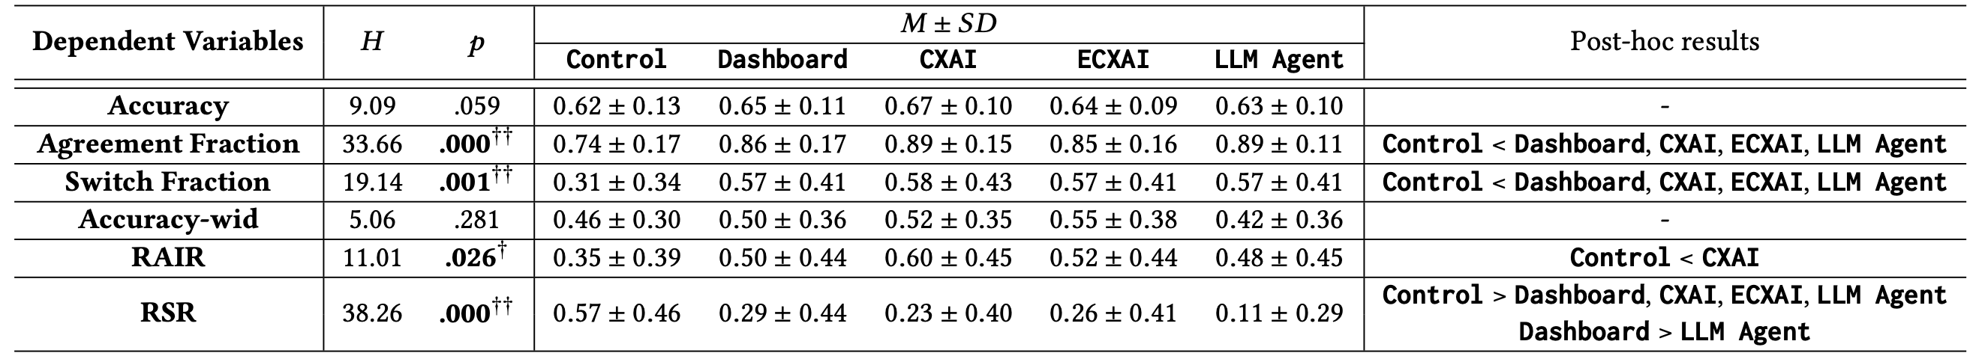
Impact on User Reliance
Both conversational XAI interfaces and XAI dashboard lead to higher user reliance (agreement fraction and switch fraction)
Only participants in CXAI condition showed significantly better RAIR than control condition
XAI interfaces lead to over-reliance (indicated by worse RSR)
Introducing LLM agents in conversational XAI interface reinforce over-reliance
Background | Motivation | Method | Results

Slide 21
Key Findings
Trade-off between creating user-friendly, seamless, and plausible conversational XAI interfaces and simultaneously fostering critical consideration of AI advice
Limited improvements in user understanding and trust brought forth by the conversational XAI interface.
Enhancing the conversation quality further reinforced the over-reliance issues
Interactive XAI interface can amplify the illusion of explanatory depth
Background | Motivation | Method | Results
Notes:
To conclude, we summarize the key findings and future directions here.
First of all, according to our experimental results, we observed limited improvements in user understanding and trust brought by the conversational XAI interface.
Secondly, we observed that After introducing LLM agents into conversational XAI interfaces, the over-reliance was further reinforced, and participants indicated worse objective feature understanding
Meanwhile, we also notice that participants with interactive XAI interfaces indicated over-reliance on the AI system, which may potentially stem from an illusion of explanatory depth
With these findings, we infer that interactive XAI interface can amplify illusion of explanatory depth

Slide 22



Towards More Effective Conversational XAI
Trustworthiness of AI advice should be calibrated within the conversation
Using conversational XAI interfaces to address AI literacy issues
Evaluative decision support deserves further exploration
Background | Motivation | Method | Results
Notes:
Rather than being persuasive, we expect effective XAI interfaces to be accessible and low-barrier interfaces that can enhance user engagement and guide users to explore their information needs.
Based on our findings, we also provide several future directions to improve the effectiveness of the conversational XAI interface
To achieve optimal human-AI decision making, we highlight an important trade-off between creating user-friendly, seamless, and plausible conversational XAI interfaces and simultaneously fostering critical consideration of AI advice

Slide 23


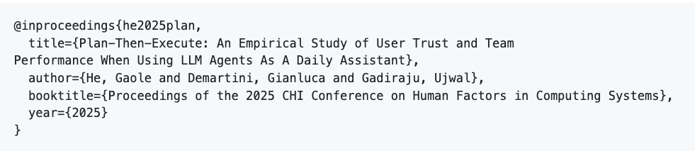
Q & A
Code and data available:
https://github.com/delftcrowd/IUI2025_ConvXAI
Thanks for listening!
On the job market for postdoc and research scientist ☺
For your interest about LLM agents, readers can refer to our recent paper:
https://richardhgl.github.io/
Notes:
Thanks for your time and listening!
If you’re interested in LLM agent workflow, please take a look at our recent work at CHI 2025.
Meanwhile, I’m also on the job market for postdoc and research scientist positions.

